Slide 1

Security Risks OF mobile Technology
Andre Hardy

Slide 2
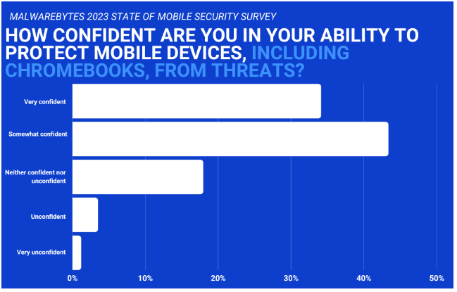
Mobile Security
77% of organizations are convinced they’re capable of protecting their mobile devices—smartphones, tablets, and laptops (including Chromebooks)—from cybersecurity threats.
A third of those organizations aren’t protecting their mobile devices at all.
And that matters—in its Mobile Security Index 2022 report, Verizon reported that 45 percent of businesses suffered a major mobile-related compromise with lasting repercussions.

Slide 3
Unauthorized access & data Interception
Risk:
Unauthorized individuals may gain access to wireless networks or mobile devices.
Wireless networks can be susceptible to unauthorized access, allowing attackers to intercept sensitive data.
Mitigation:
Use strong, unique passwords and implement multi-factor authentication.
Regularly update and patch devices and systems.
Use strong encryption protocols (e.g., WPA3 for Wi-Fi) to secure wireless communications.
Implement Virtual Private Networks (VPNs) to encrypt data transmitted over the network.

Slide 4
Device Theft & Loss
Risk:
Mobile devices are often small and portable, making them prone to theft or loss.
Loss or theft of mobile devices can lead to unauthorized access to sensitive data.
Steps:
Enable device encryption to protect stored data.
Implement remote wipe capabilities to erase data in case of loss or theft.
Implement strong device authentication (e.g., PIN, biometrics).
Encourage users to report lost devices promptly.

Slide 5
Bluetooth & NFC Vulnerabilities
Risk:
Bluetooth and NFC connections can be exploited for unauthorized access or data interception.
Bluetooth-enabled devices may be vulnerable to an attacker gaining control of their device or information stored on it.
Steps:
Disable Bluetooth and NFC when not in use.
Ensure that devices are not discoverable by default.
Keep firmware and software up to date to patch vulnerabilities.
Use secure pairing methods.

Slide 6
Malware & Malicious Apps
Risk:
Mobile devices are susceptible to malware and malicious applications.
Malware and malicious apps can compromise security and privacy, such as give an attacker access to your organizational data or control of your device.
Mitigation:
Install reputable security software.
Regularly update operating systems and applications.
Install reputable antivirus and anti-malware applications.
Only download apps from official app stores and be cautious of permissions requested by apps.
Keep operating systems and apps updated with the latest security patches.

Slide 7



Here’s a list of some organizational duties you might want to include in your mobile security policy:
Use a mobile device management (MDM) platform. It allows an administrator to perform remote tasks, such as troubleshooting and wiping devices after a theft. More importantly, an MDM can be used to enforce strong password practices and deploy software updates.
Ensure employees use a VPN to connect to the company network. In this case, it’s vital to encrypt data in transit, so you don’t have to worry about your employees using public Wi-Fi.
Use two-factor authentication (2FA).
Educate employees on best practices for mobile security.

Slide 8

references
“How small businesses can secure employees’ mobile devices” Posted: May 4, 2023 by Jovi Umawing
https://www.malwarebytes.com/blog/news/2023/05/duties-a-small-business-must-do-to-secure-employees-mobile-devices
“Key takeaways from Malwarebytes 2023 State of Mobile Cybersecurity” Posted: January 23, 2023 by Bill Cozens
https://www.malwarebytes.com/blog/business/2023/01/key-takeaways-from-malwarebytes-2023-state-of-mobile-cybersecurity-survey
“What is mobile security?” 2020 IBM
https://www.ibm.com/topics/mobile-security
“Business Mobile Secure” 2023 Verizon
https://www.verizon.com/business/products/security/mobile-device-endpoint-security/business-mobile-secure/#:~:text=Business%20Mobile%20Secure%20is%20built,for%20desktop%20and%20mobile%20devices.
“Mobile security for business” by Nationwide Business Solutions Center 2023
https://www.nationwide.com/business/solutions-center/cybersecurity/mobile-security

